Slide 1

Assignment 2:
Conjoint Analysis
By Nicholas Feng Schaefer

Slide 2
Table of Contents
Assignment 2A
  Question 1
  Question 2 / Question 3
  Question 4
Assignment 2B
  Utility for Attribute “price”
  Utility for Attribute “kind
  Utility for Attribute “variety”
  Utility for Attribute “aroma”
  Conjoint Analysis for Tea

Slide 3
Assignment 2A
Sawtooth Online Joint Exercise

Slide 4
Question 1
The survey experience was interesting. I knew beforehand which food I preferred over others, but I didn’t know which factors influenced my purchasing decision the most. I’ve identified that I don’t like to wait long and pay higher prices.

Slide 5
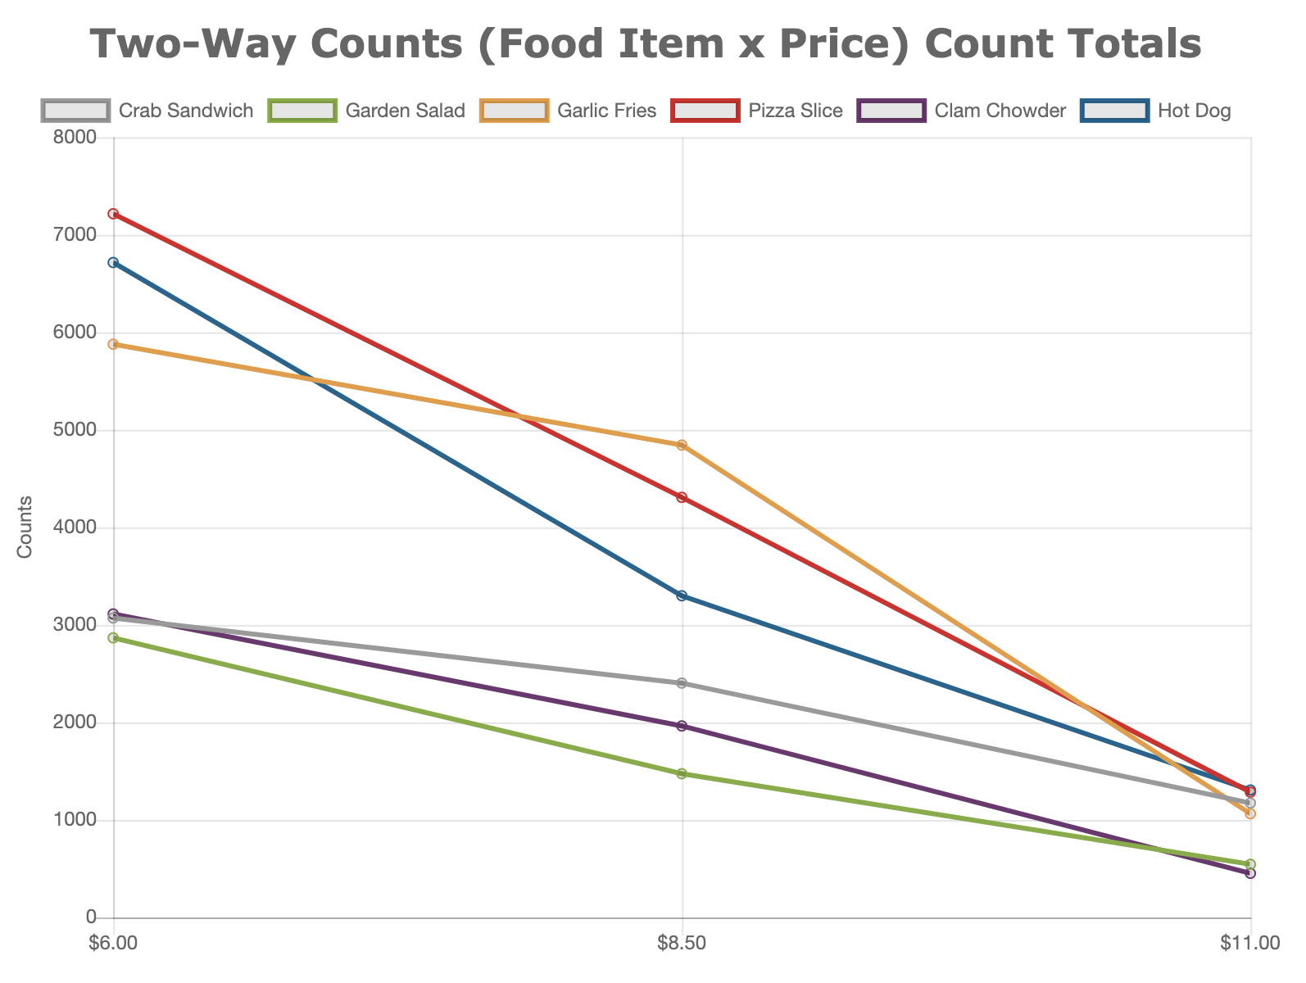
Question 2 / Question 3
General downward trend.
  When prices go up, demand goes down
Most popular food items (in order):
  At $6.00: Pizza Slice, Hot Dog, Garlic Fries
  At $8.50: Garlic Fries, Pizza Slice, Hot Dog
  At $11.00: Hot Dog, Pizza Slice, Crab Sandwich
Consumer seem less price sensitive for Crab Sandwich, Clam Chowder, and Garden Salad. And more for Pizza Slice, Hot Dog, and Garlic Fries

Slide 6
Question 4
Demand curves usually slope downward from the left (lower prices) to the right (higher prices).
Consumers, in general, are less price sensitive to higher-end goods and services.
Consumers usually don’t like to wait when there are immediate substitutes.

Slide 7
Assignment 2B
Conjoint Analysis for Tea

Slide 8
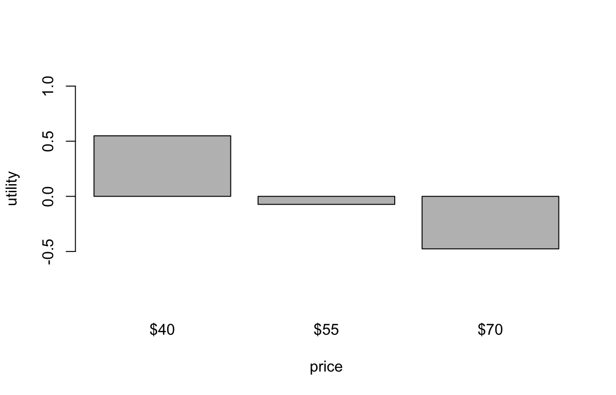
Utility for Attribute “price”

Slide 9
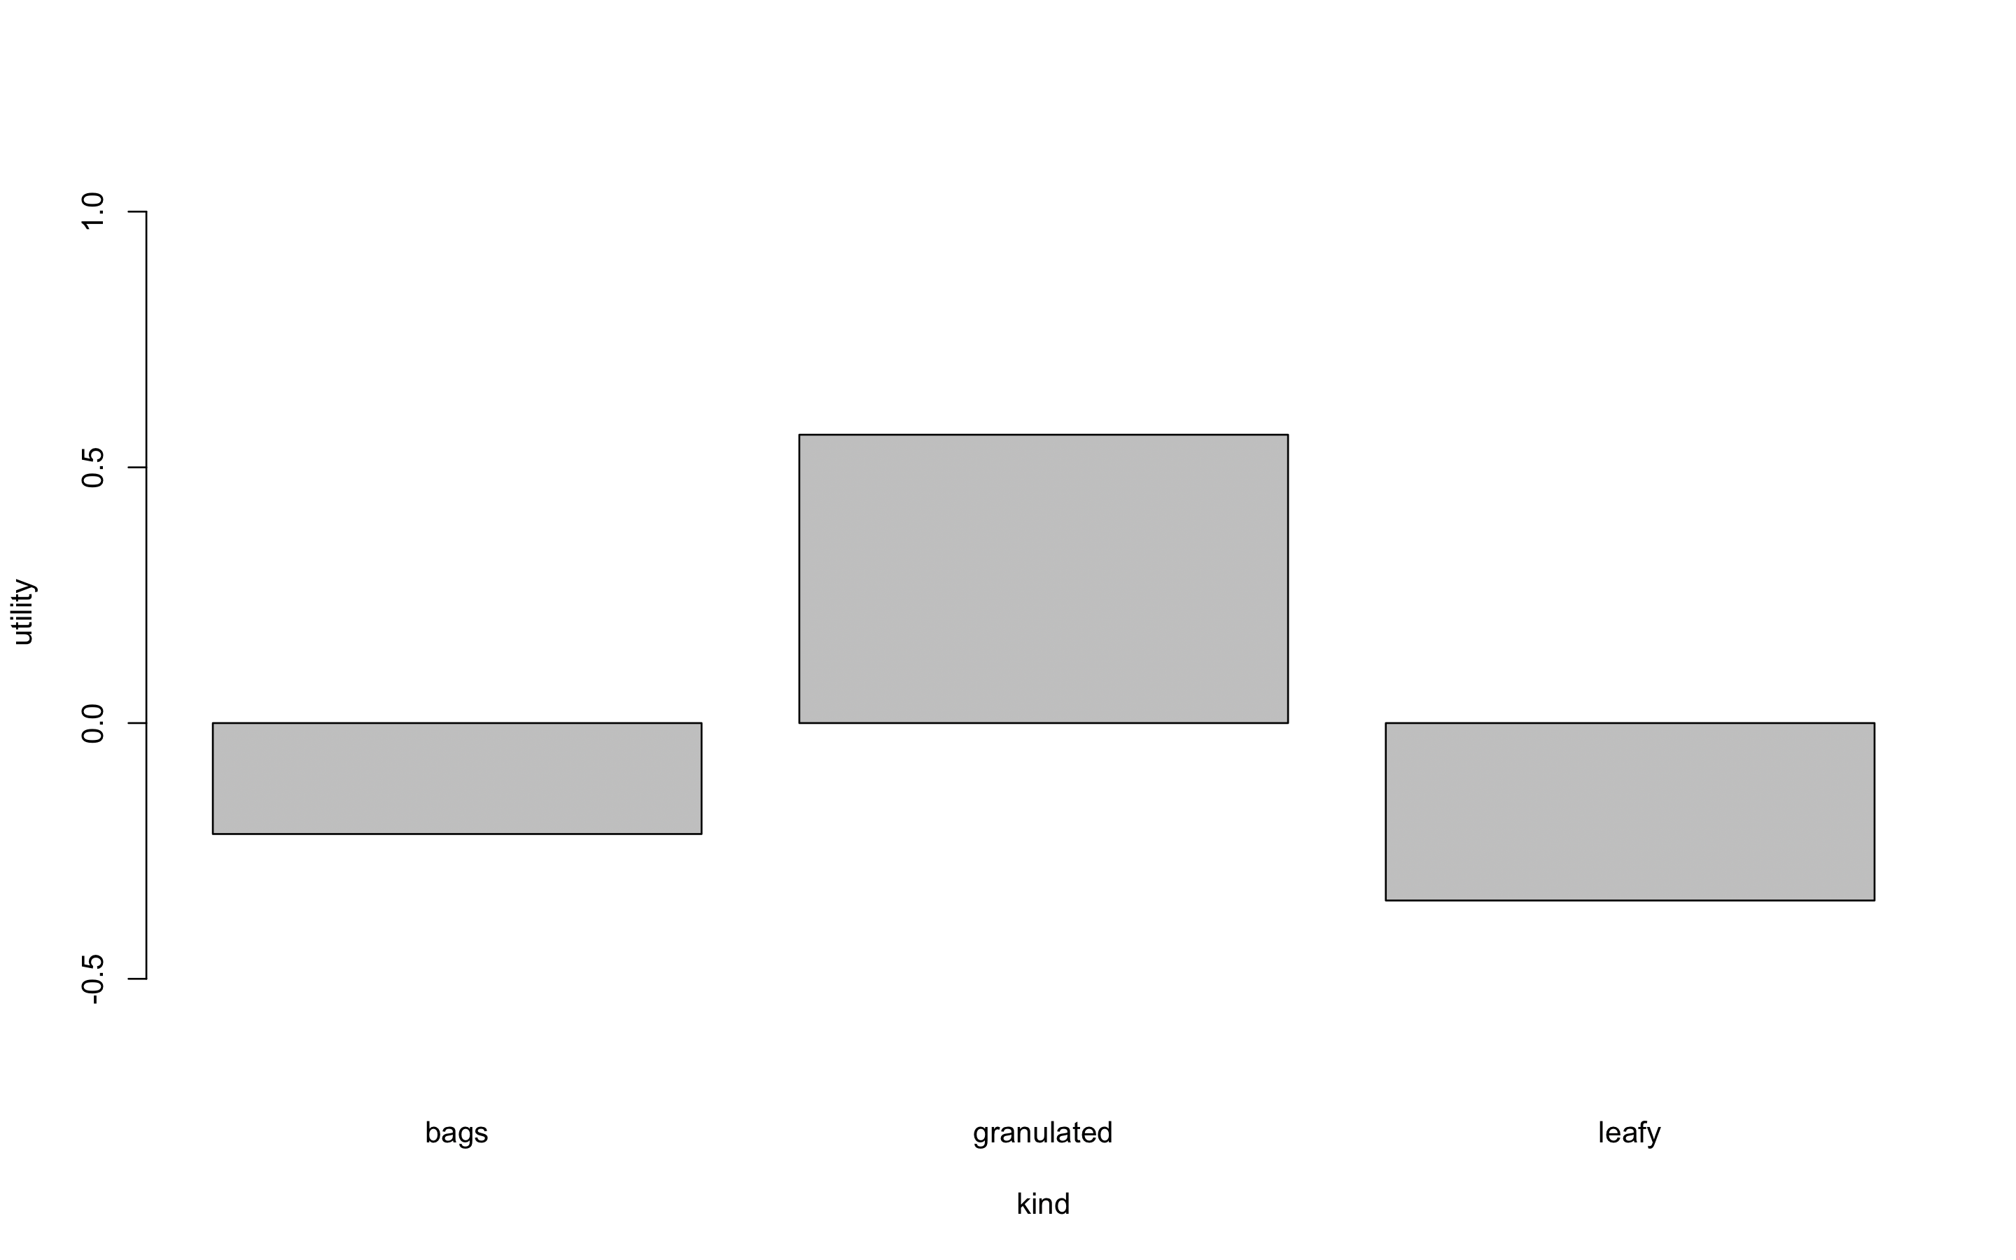
Utility for Attribute “kind”

Slide 10
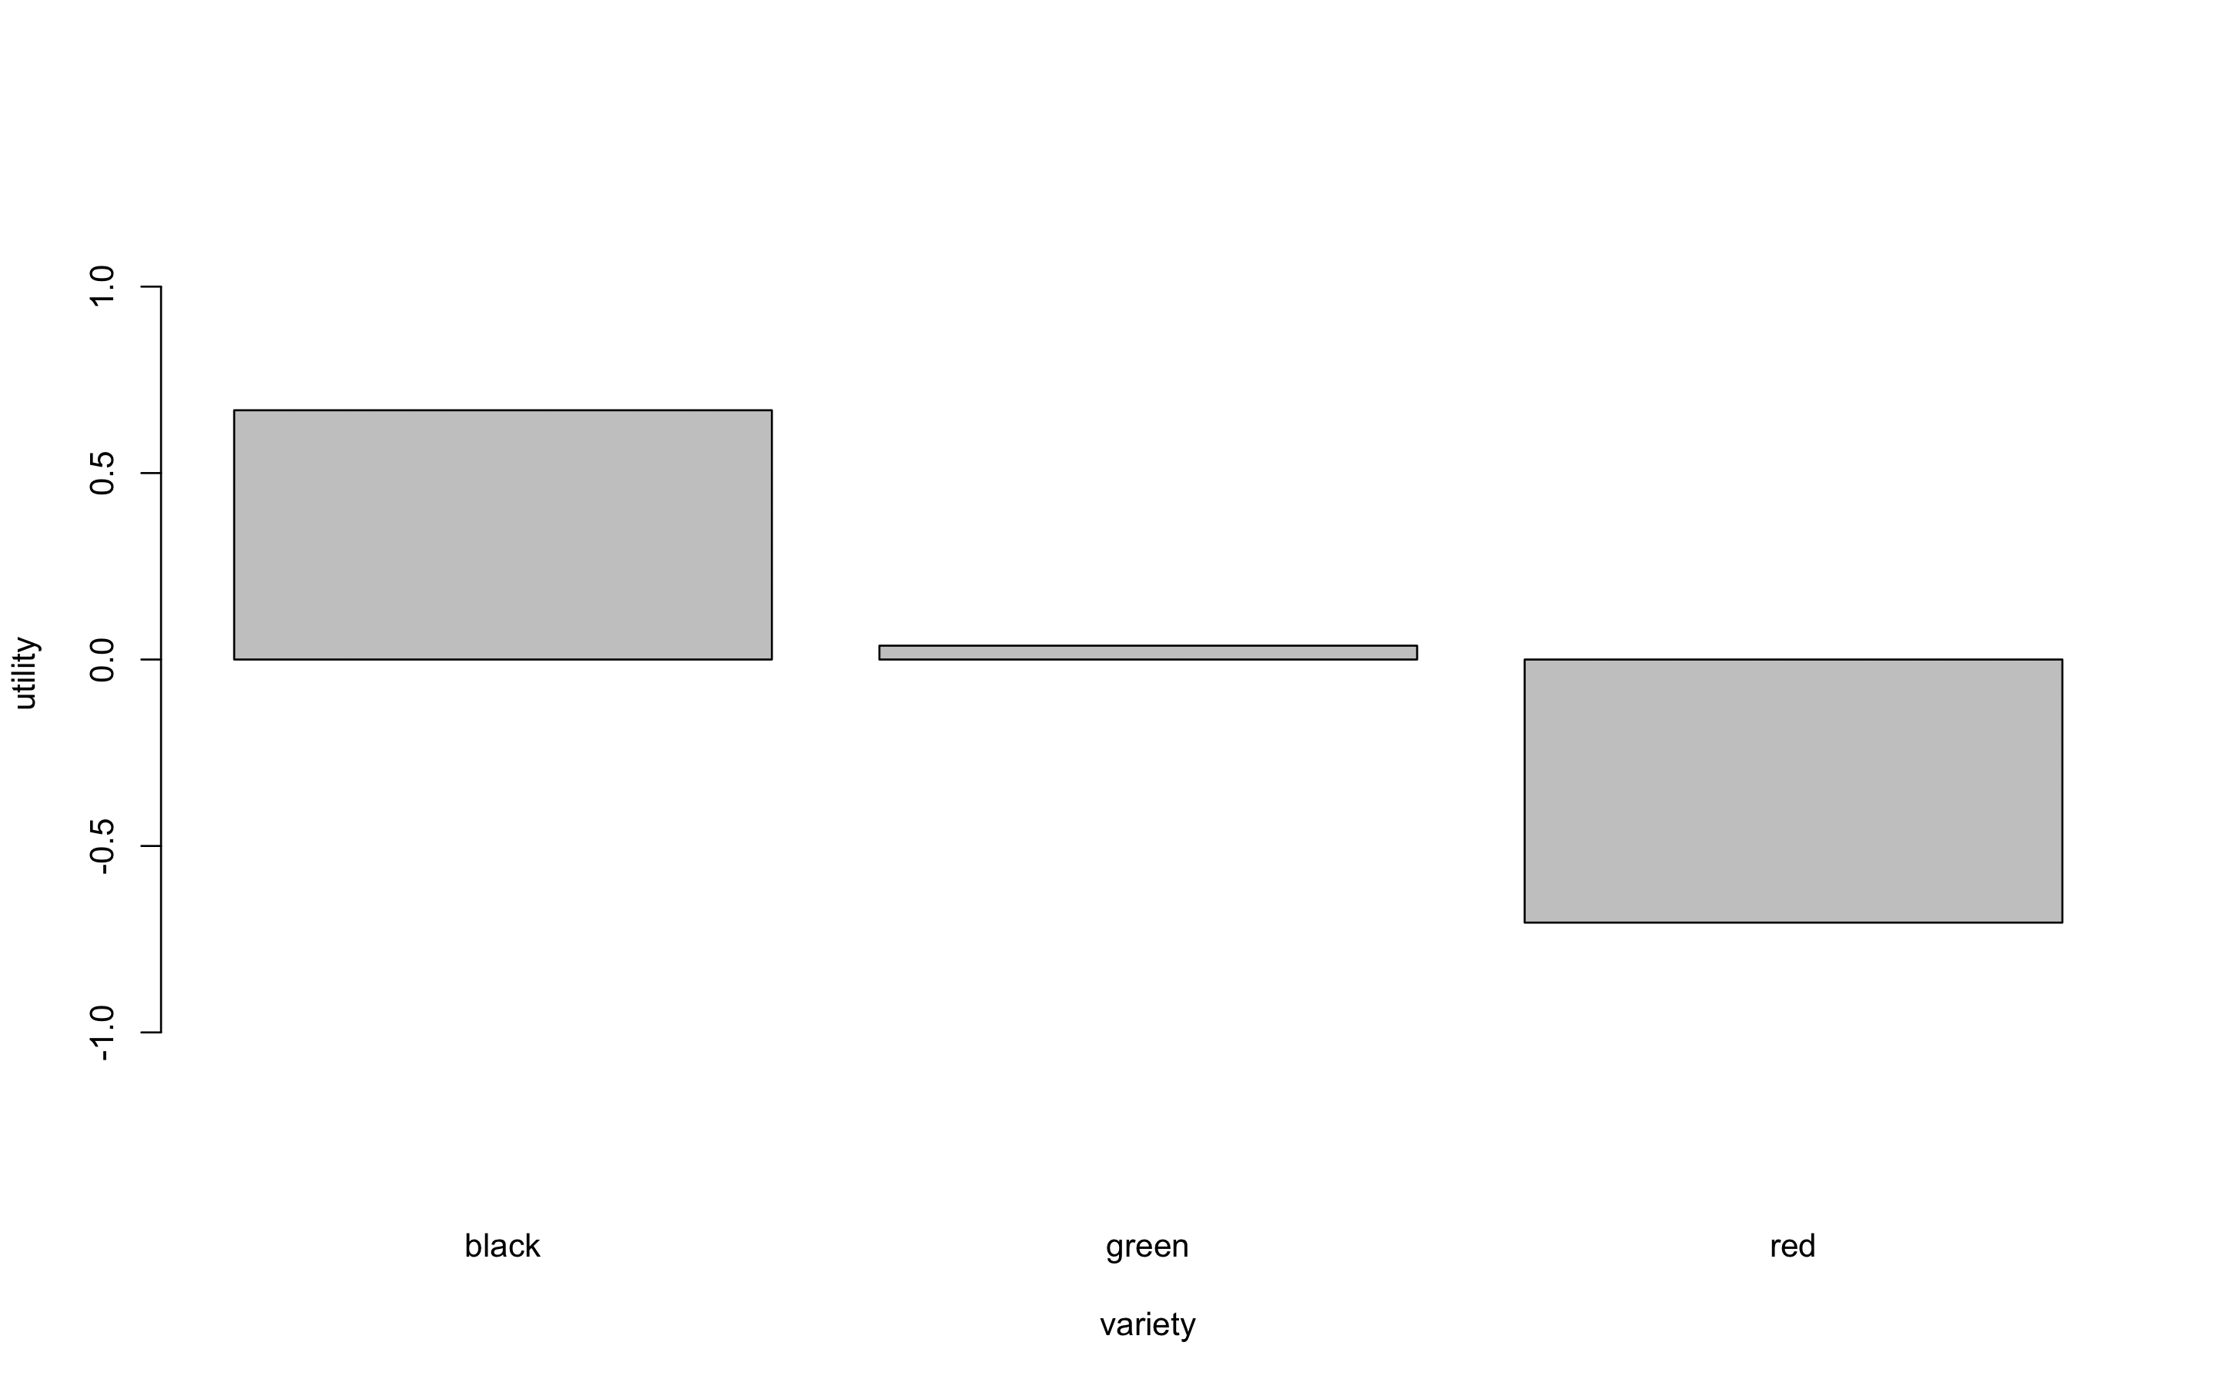
Utility for Attribute “variety”

Slide 11
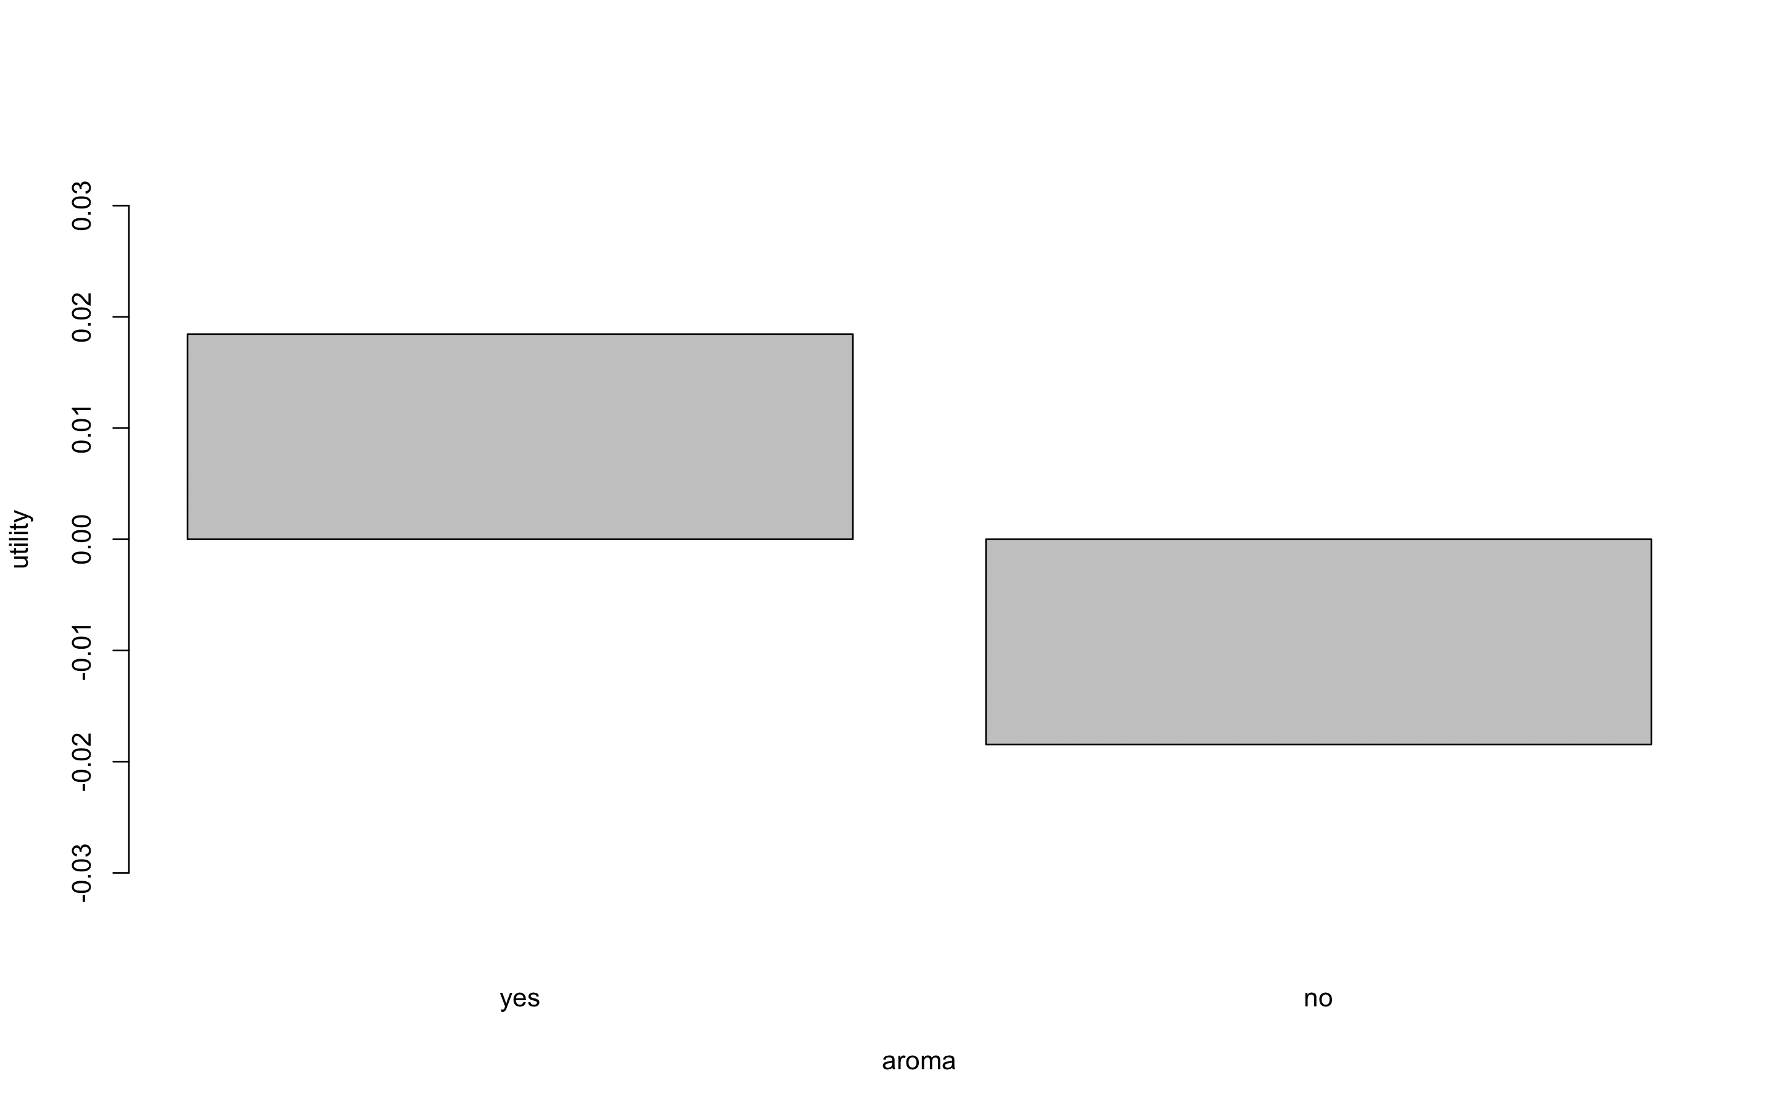
Utility for Attribute “aroma”

Slide 12
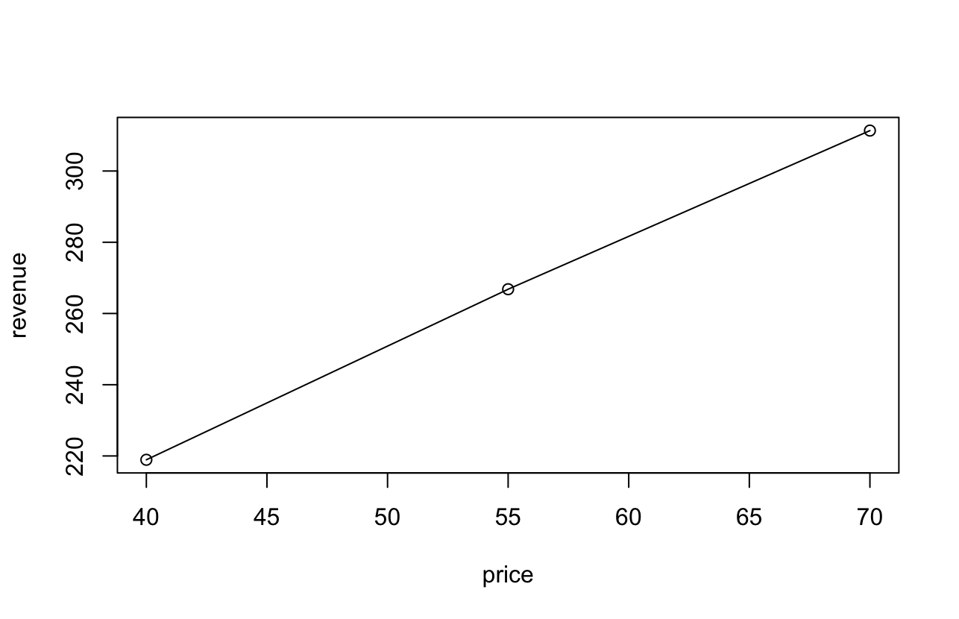
Conjoint Analysis for Tea
Most favorable profile for tea:
  Kind: granulated
  Variety: black
  Aroma: yes
Optimal demand and resulting revenue:
  Demand: 4.45
  Revenue: $311.35

